Slide 1
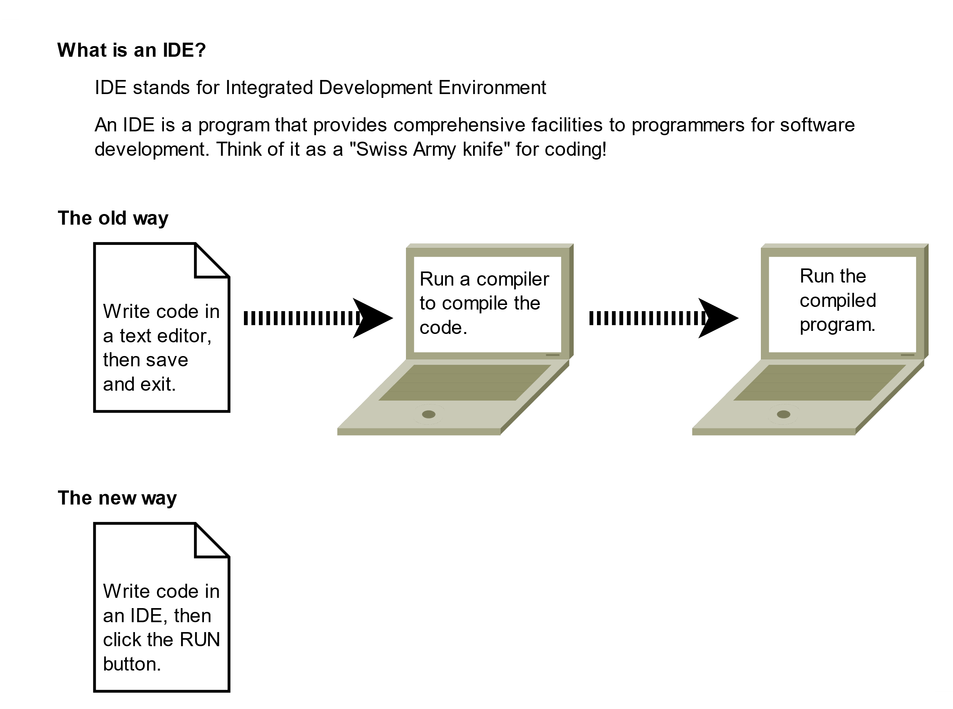

What is an IDE?
What is an IDE?
IDE stands for Integrated Development Environment
An IDE is a program that provides comprehensive facilities to programmers for software development. Think of it as a "Swiss Army knife" for coding!
The old way
The new way
COMPLETE JAVA MASTERCLASS
What is an IDE?

Slide 2
Key features of an IDE
Key Features of an IDE:
Code Editor - Write and edit your code with syntax highlighting and auto-completion.
Debugger - Find and fix errors in your code step-by-step.
Compiler/Interpreter – Run your code directly from the IDE.
Code Navigation - Quickly jump to functions, classes, and files.
Intelligent Code Assistance - Get suggestions, warnings, and automatic fixes.
Why use an IDE?
Productivity - Write code faster with smart suggestions.
Error Detection - Catch mistakes before running your code.
Easy Debugging – Step through code to understand what's happening.
All-in-One - Everything you need in one place.
COMPLETE JAVA MASTERCLASS
What is an IDE?

Slide 3
Some popular IDEs
Java IDEs
IntelliJ IDEA | Full-featured programmer's IDE by JetBrains. Supports development in: Java, Python, Kotlin, Ruby, TypeScript, Go, HTML and more.
Eclipse | An open-source Java IDE, released as an alternative to NetBeans. Very mature and full-featured.
NetBeans | The original Java IDE, supported by Oracle.
Visual Studio Code (VS Code) | VS Code can be used for Java development after installing an extension pack for Java.
BlueJ | A Java IDE designed for beginners, used in education but also very capable for real projects.
COMPLETE JAVA MASTERCLASS
What is an IDE?

